Slide 1
An Overview of
Electroconvulsive Therapy
Randall T. Espinoza, MD, MPH
Clinical Professor
Medical Director, ECT Program
Resnick Neuropsychiatric Hospital at UCLA

Slide 2
The ECT Team at UCLA
ECT Nurses – Juanita Jackson, Francia Black, Jocelyn Miel; 3S staff
CCPs – Lupe Perez, Iris, et al
UCLA Anesthesiologists – Drs. T. Grove, Mai, Myo, et al.
ECT Attendings – S. Chen, A. Kaufman, H. Lavretsky
ECT Capacity/Review Consultants – Drs. Wu, Cogen, Casaus, Zorick, et al
ECT Review Committee of NPH – Dr. Cook et al
Geriatric Psychiatry Division (Drs. G. Small, J. Spar)

Slide 3
Agenda
Brief historical overview of early biological treatments for mental illness
(re)Discovery of Convulsive Therapy
Myths and Misconceptions of ECT
Resurgence of ECT
Modern ECT Practice: videotape
Current questions and future challenges

Slide 4
Treatment Approaches in Psychiatry
Psychological treatments
Social and rehabilitative treatments
Physical treatments
  Pharmacological agents
  Brain stimulation
    Convulsive: chemical, electrical (ECT*), magnetic (MST)
    Non-convulsive: rTMS*, VNS*, FEAST, tDCS, TNS
  Psychosurgery
    Ablative surgeries: non-reversible
    Deep Brain Stimulation (DBS): reversible
Others: light, sleep deprivation, exercise, yoga, mindful awareness, etc
* Only FDA-approved BSTs

Slide 5
Evolution of Biological Therapies in Psychiatry
Psychosurgery
Brain Stimulation Therapies
Frontal Lobotomy
Insulin Coma
1930
1940
1950
1960
1970
1980
1990
2000
2010
Discovery, Practice and Ongoing Evolution of ECT
1st Pharmacologic Revolution
2nd Pharmacologic Revolution
Others

Slide 6
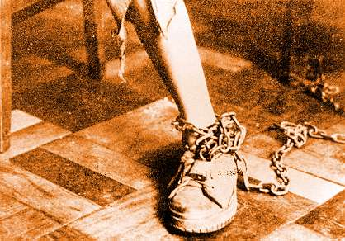
Mental Health Care Pre-1930’s
Custodial care
Psychoanalysis
Biological therapy
  Narcosis
  Hydrotherapy

Slide 7
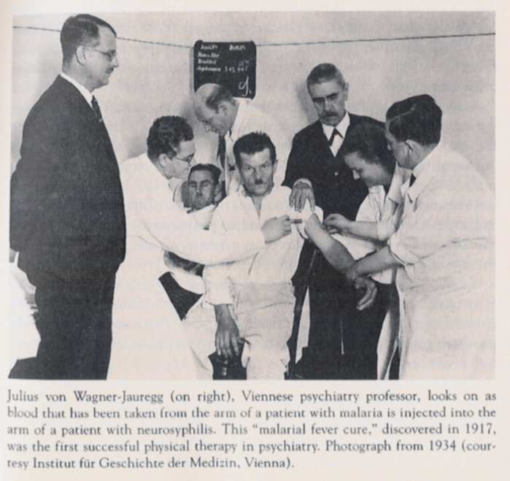
1910’s: Julius von Wagner-Juaregg (Nobel Prize, 1927)
Malarial treatment of General Paresis of the Insane

Slide 8
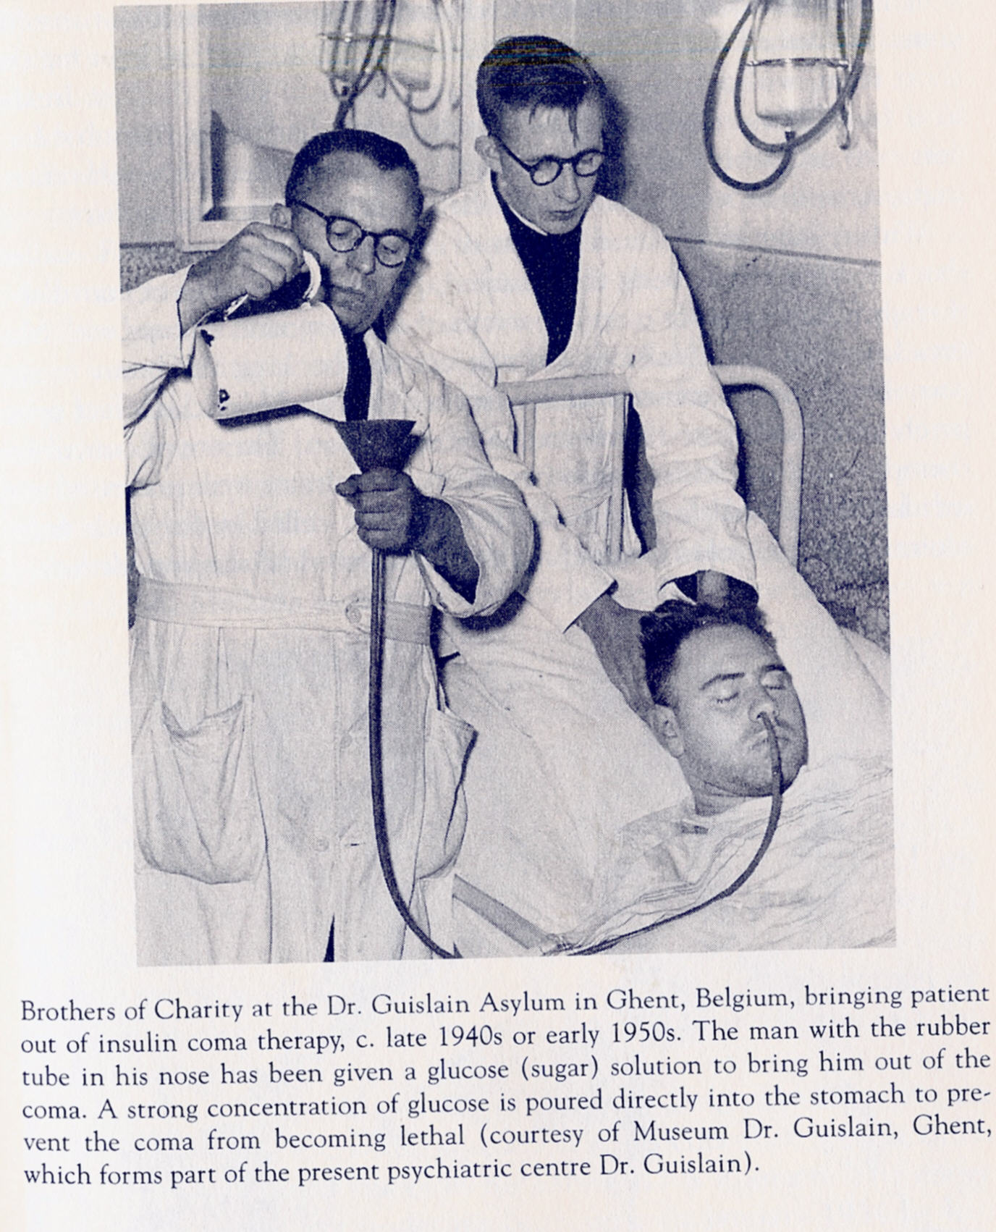
1930’s: Manfred Sakel (Austrian internist)
Insulin Coma for schizophrenia: “Shock Therapy”

Slide 9
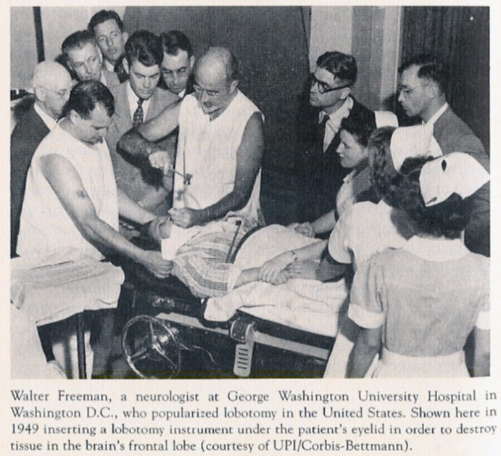
1935: Egas Moniz (Lisbon neurologist)
Psychosurgery: frontal lobotomies (Nobel Prize 1949)

Slide 10
The First Convulsive Therapies
Ladislau von Meduna: 1934
  theory of antagonism between epilepsy and schizophrenia
  chemical induction of seizures: camphor and later pentylenetetrazol
  inconsistent induction; feared by patients; unmodified convulsions; unpredictable

Slide 11
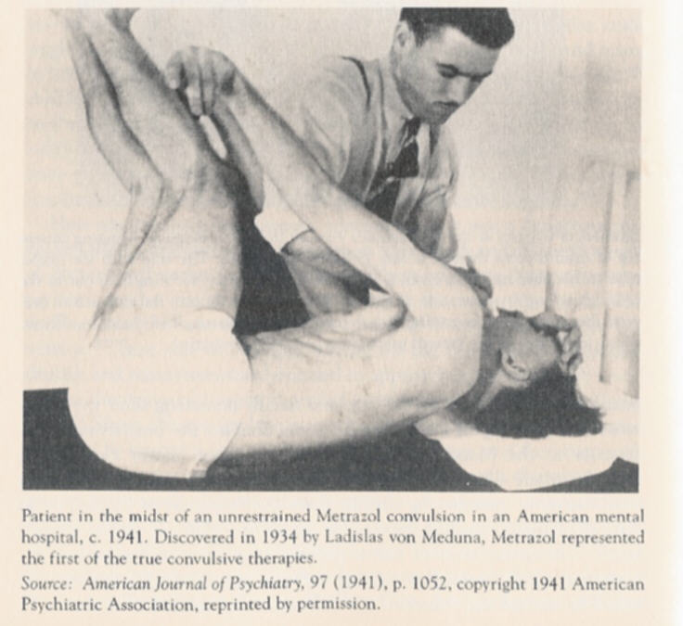
The First Convulsive Therapies

Slide 12
The Discovery of
Electroconvulsive Therapy
Ugo Cerlitti and Lucio Bini: 1938
  fortuitous discovery of electrical induction
  therapeutic effects the same
  more consistent, predictable, and when modified, tolerated and accepted
David Impastato – October 21, 1939
  1st ECT treatment at Columbus Hospital in NYC

Slide 13
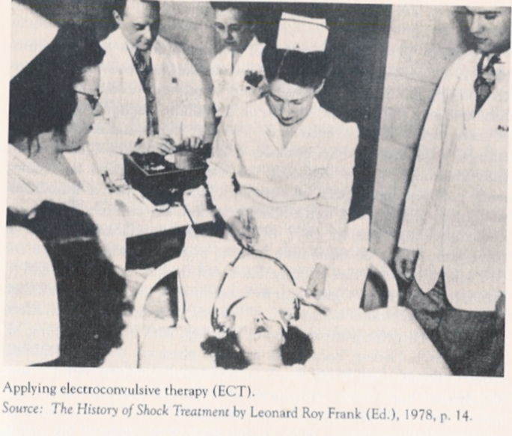
Early Electroconvulsive Therapy

Slide 14
ECT, The Early Years (1940s to 1950s)
Widely available in most state and private hospitals and academic centers.
Extensively researched:
  Mechanisms of action
  Hemodynamic/Respiratory/CNS changes: safety
Technologic issues:
  Anesthetic agents: thiopental, methohexital, etc.
  Muscle relaxation agents: curare, succinylcholine
  Electrical current applications
    Sinusoidal wave machines
    Bilateral lead placement

Slide 15
ECT, The Early Years: 1940 – 1950’s
SAFE and NO BRAIN DAMAGE
  Low mortality risk
  Low morbidity with treatment modifications
  But cognitive side-effects were a serious problem
Indications for ECT
  Mood disorders
  Catatonia
  Primary psychoses
But also probably used inappropriately

Slide 16
The 1st Psychopharmacologic Revolution
1952 Lithium
1954 Chlorpromazine
1960’s Tricyclic antidepressants and others

Slide 17
The Decline of ECT
Reported overuse, misuse, and abuse
  Totalitarian states: USSR, China, Iraq, etc.
  Behavioral control vs. punishment
Banned in several municipalities and severely restricted in many others
  California
  Texas
  Vermont
  Wisconsin
Viewed negatively by the public
  Media Depiction
  Anti-psychiatry movement: Scientology
No longer widely available

Slide 18
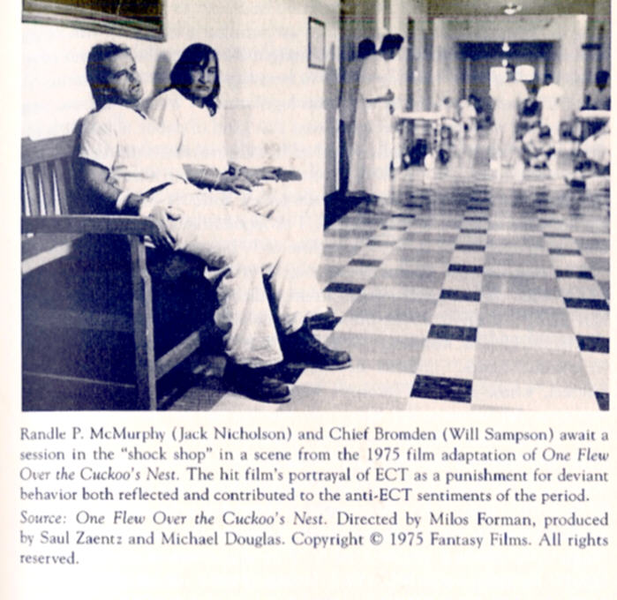
Media Depictions of ECT

Slide 19
Myths of ECT
Shock and convulsion are essential.
Memory loss is severe and always permanent.
ECT results in brain damage.
ECT is at best palliative and is less effective than other available forms of treatment.
The lack of understanding of the underlying neurophysiologic mechanisms argues against its use.

Slide 20
The Rehabilitation of ECT
1978 American Psychiatric Association
1981 British Royal College of Psychiatry
1990 APA Task Force on The Practice of ECT: Recommendations for Treatment, Training and Privileging
2001 APA Task Force on ECT
2003 UK ECT Review Group
2011 anticipated APA/ISN review

Slide 21
ECT “Resurgence” in the 1990’s
Drug limitations recognized
  Treatment resistance
  Special populations
  Evidence-based medicine (Lancet 2003)
    Efficacy and effectiveness studies
    Treatment algorithms and guidelines
Increased understanding of technical issues
  Seizure threshold concept
  Lead placement
Better patient selection and matching to treatment
Public was better informed, but misconceptions persist. Grassroots advocacy groups are helping to dispel notions against ECT.

Slide 22
ECT Principles: Energy I
Application of a small amount of electrical energy to the brain to elicit a generalized seizure: 10 – 100J (or up to 572 mC charge)
  Cardiac defibrillation: 100 – 360J
  100-watt bulb will consume 100J in 1 second
  Blue tip kitchen match = 1 btu (1000J)
  Pot of coffee takes 2 million joules (2000 btu)
Note that even applying the max energy of 100J is almost always less than what is typically used in cardiac defibrillation
ECT goal: Apply the least but most effective amount of energy to effect clinical improvement but minimize cognitive side-effects

Slide 23
ECT Principles: Energy II
Charge (mC) vs. Joules (J)
  Ohm’s Law: V = I x R where V is voltage; I, current; R, resistance
  In biological systems; R is replaced by Impedance
  A more precise measure is Charge, q
Deriving charge (energy) calculations is based on parameters which include:
  PW: pulse width; Hz: frequency; time: in milliseconds; i: current
  Can vary charge (or energy) over Pulse Width (PW), frequency (Hz), duration (sec), and amount of current (constant, i)
  Efficiency of seizure elicitation varies according to parameters chosen and chronaxie of neuron
  Different lead placements also require different energy settings

Slide 24
ECT Principles: Seizure Threshold (ST)
ST: The minimum amount of energy required to elicit a generalized seizure
  Varies in the population: 9 to 40-fold (Sackeim 1987)
Seizure titration is necessary and recommended (2001 APA ECT Task Force Report).
Variable | Lower → → → → → Higher
Sex | Female | Male
Lead placement | RUL | BL < BF
Age | Younger | Older
Medications | Pro-convulsant | Anti-convulsant
Frequency / # of treatments | Beginning, fewer | Later, more
Waveform parameters | Brief pulse | Sine-wave
Illness characteristics | Variable effects

Slide 25
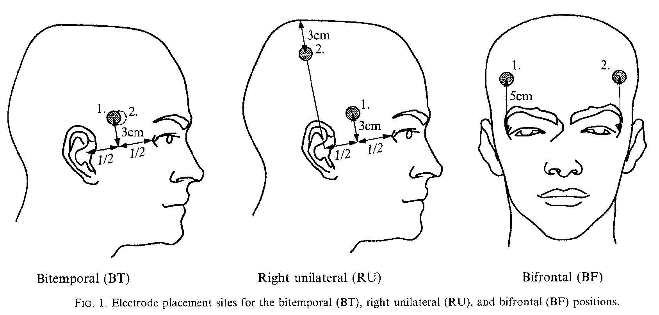
Lead Placements in ECT
RUL D’Elia Placement
  Less cognitive impairment
  Better tolerated than BT
  Brief and ultrabrief PW usage
Bilateral Placement
  3 types: BT, BF, asym. BF
  BT is always worse cognitively, but may have slight efficacy advantage

Slide 26
ECT Patient Selection – 1
What does ECT help
What does ECT not help?
Who should or should not get ECT?
ECT does not treat every psychiatric condition and
Not everyone who has a recognized or appropriate condition is appropriate to receive ECT.

Slide 27
ECT Indications: DSM-IV Diagnosis
2001 APA Task Force on ECT
Major Depression, Dysthymia
Bipolar Disorder, Cyclothymia
Schizophrenia and other “idiopathic” psychosis
Mood or psychiatric disorders due to GMC
Medical disorders
  NMS
  Catatonia
  Intractable seizure disorder
  Hypopituitarism?
? Dementia, Delirium

Slide 28
Conditions or Situations where ECT is not recommended
2001 APA Task Force on ECT
Axis I conditions ECT does not appear to help:
  Primary anxiety disorders
  Primary active substance abuse/dependence disorders
  Eating disorders
  Somatoform disorders
  Dissociative disorders
  Developmental disorders
Axis II conditions
  If primary, ECT does not appear as effective nor is response as robust
  Patients may also not tolerate (cognitive) side effects
Bear in mind 3 types of comorbidity
  Multiple Axis I diagnoses
  Axis I and Axis II
  Medical comorbidity

Slide 29
ECT Patient Selection – 2
When is it time to consider ECT?
  ECT Primary criteria
  ECT Secondary criteria
Must patients have tried and failed (multiple) medication trials?
  How many?
  Which ones or which classes?
How long should or must a person be depressed?
How severely depressed should or must a person be?
What do available treatment algorithms or guidelines advise?
2001 APA ECT Task Force Report; APA Guidelines on Treatment of Depression; Texas Medication Algorithm Project

Slide 30
ECT Indications: Criteria for Primary Use
2001 APA Task Force on ECT
Need for rapid, definitive response
  High and active suicidality, homicidality
  Severe inanition, malnutrition, etc
  Psychotic depression, catatonia, NMS, etc
Optimal risk-benefit index
N.B. – Patient preference

Slide 31
ECT Indications: Criteria for Secondary Use
2001 APA Task Force on ECT
Treatment failure/resistance
  Number of trials
  Classes and combinations of medications
Optimal risk-benefit index
Deterioration need for rapid, definitive response

Slide 32
Advantages of ECT
Superior efficacy (80 - 90%) in severe depression compared to antidepressant medication
Good efficacy (50 - 60%) in medication resistant depression
More rapid onset of action
Good safety profile
Absence of medication side effects

Slide 33

Disadvantages of ECT
Minor treatment side effects
Subjective side effects

Slide 34
Major medical sequelae are uncommon.
less serious, but more prevalent
  transient arrhythmias
  oral trauma
  dental injury
  mild confusion
  falls (especially in elderly)
serious
  delirium
  (malignant) arrhythmias
  prolonged apnea
  prolonged seizure
  status epilepticus
    defined as >10 min

Slide 35
Morbidity and Mortality in ECT
Mortality is estimated at 1 in 100,000 patients or 1 in 1,000,000 treatments.
Cardiovascular complications remain the leading cause of morbidity and mortality.
Cerebrovascular complications are rare.
Most complications usually occur in the immediate post-ictal period.
Always weigh risk/benefit index

Slide 36
Absolute Contraindications to ECT
2001 APA Task Force on ECT
N O N E

Slide 37
Relative contraindications
2001 APA Task Force on ECT
space occupying lesion: increased CNS pressure
recent (<3mos) myocardial infarction
leaky/unstable aneurysm or AVM
recent intracerebral hemorrhage
retinal detachment
pheochromocytoma
situations assoc. w/ high anesthetic risk
  3rd trimester pregnancy
  Low cardiac output
  Unstable arrhythmia, etc

Slide 38
Understanding Cognitive Side-effects in ECT
Variables
  Patient characteristics, e.g., age, education
    Inter-individual
    Intra-individual
  Effects of underlying illness: type, duration, severity
  Effects of current treatments: medications
  Effects of concurrent medical illness
Time of assessment
Effects of ECT treatment parameters
  Lead placement
  Energy and stimulus characteristics
  Number of treatments

Slide 39
Disadvantages of ECT
2001 APA Task Force on ECT
Cognitive impairment
  Immediately on recovery - postictal confusion; clears as the day progresses; regain full orientation
  Cumulative over the series of treatments - recent and remote memory loss; usually transient.
    Anterograde amnesia: develops first and most rapidly; uneven memory loss of events that occur during and around index ECT; resolves once ECT stops
    Retrograde amnesia: develops more gradually and cumulatively; memory loss for 2 – 8 weeks before treatment; takes up to 6 months to resolve after ECT stops; associative memory remains intact

Slide 40
Disadvantages of ECT
2001 APA Task Force on ECT; Prudic 2000; Lisanby 2000
Cognitive impairment (cont..)
  in 20-25% of patients: uneven permanent autobiographical memory loss
  in surveys, patients who admit to dysfunction do not generally consider it a problem.
  in some patients: persistent subjective memory complaints without demonstrable, objective neuropsychological test findings
  correlation between complaints and residual psychopathology
    heightened sensitivity to normal forgetting
    perpetuation of secondary gains to disability

Slide 41
Informed Consent and ECT
 |  | Status
 |  | Voluntary | Involuntary
 |  | Advise and wait 24 hours Obtain consent Obtain independent verification | -Same, but with extra evaluation -Court review* -Hospital counsel -Private or public counsel
 |  | -Same, but with extra evaluation -Court review -Hospital counsel -Private or public counsel | Same, but with extra evaluation -Court review -Hospital counsel -Private or public counsel
A legal consent process exists.
There is NO national standard and the process can vary substantially by local jurisdiction, regulation and custom.
California – Dept. Mental Health
  Stringent requirements: 24-hours to decide after advisement; verification of capacity; monthly (30-day) re-consent; 30 treatments/yr limit. Documentation intensive.
  Impedes access?
There is no such thing as “Involuntary ECT” in California (WIC 5325-5226.91):
  Voluntary vs. involuntary status
  With or without capacity to consent to treatment
  Conserved patients require court review
  Any patient who retains capacity to refuse will never be given ECT in CA
Yes
Capacity
No
* Court review may not be needed if attorney agrees that capacity to consent is retained.
Notes:
41

Slide 42
ECT Referral Process
Call for an ECT consult: patients cannot self-refer
ECT Consultant
  Is usually the ECT treating psychiatrist
  Is a collaborative partner in management
  Helps identify appropriate patients for and timing of ECT
  Aids in preparation to begin series
    Other work-up or referrals
    Medication management or adjustments during series
    Opinion about inpatient or outpatient ECT
    Sets realistic expectations
  Explains ECT procedure, i.e., provides ECT advisement
  Assists with legal questions and paperwork about ECT

Slide 43
Pre-ECT Work-Up
ECT responsive illness?
Past Psychiatric history
  Number/duration of episode(s)
  Severity of illness
  Number/type of medications or psychotherapy treatments
  IP and OP care
  Substance abuse
Past ECT history
  Lead placement
  Type of response
  Problems with treatment
Past Medical history
  Stable vs. unstable
  Likely to alter risk of ECT
Family Medical / Psychiatric history
  Past history of ECT
  Problems with anesthesia
Social History
  Degree of functional disability
  Work status
  Type of home support
  Family or SO involvement
Review of Systems / Physical Exam
Mental Status Exam
  Mood scales
  Cognitive baseline
Laboratory / Radiologic studies
Consultations

Slide 44
Pre-ECT Work-Up: Consultations
“Medical Clearance” - There is no such thing. Generally, asking for “pre-op evaluation” about risk:
  low, medium or high.
Pre-operative evaluation for an elective, non-cardiac procedure ⇒ MD’s must be familiar with ECT and the attendant risks, hemodynamic changes/stresses, etc.
Requires discussion, collaboration and coordination among the ECT treating MD, Referring (I/O) Psychiatrist, PCP, anesthesiologist, and other consultant(s).
Anesthesiology:
  Airway management in peri-ECT period
  Acute hemodynamic management during ECT
“Directed” consults - cardiology, neurology or neurosurgery, pulmonary, dentistry, etc.

Slide 45
Pre-ECT Work-Up:
Elective, Non-cardiac Procedure
No such thing as EMERGENCY ECT.
Cardiovascular: hemodynamic stability
Pulmonary: airway compromises, etc.
Neurologic: focal changes; fundoscopic exam
Musculoskeletal / dental: bone, teeth
GI: GERD
Prior surgery anesthesia outcomes?

Slide 46
Medications during ECT course
Goal: continue medications that make ECT safe BUT do not interfere with procedure
  Continue cardioprotective meds except diuretics
  Monitor diabetics closely
  Therapeutic drug monitoring
Psychotropics
  Stop lithium and other proconvulsants
  No clear evidence that continuing most antidepressants is helpful or necessary
  Do not use or continue meds with anticonvulsant effects which includes most hypnotics
  Antipsychotics can be helpful and can continue

Slide 47
Pre-ECT Work-Up:
Laboratory / Radiologic Studies
Absolute: lytes (k +); EKG; therapeutic drug monitoring
Considered: CBC; LFT’s; PT/INR; RUA/RUDS; others as indicated
Neuroimaging
  Not indicated routinely
  New focal change: CT/MRI/QEEG
CXR: case by case.
Spinal X-rays: no longer done routinely.

Slide 48
Stages of Management in ECT
Index series
Continuation/Maintenance
Consists of 6 – 12 treatments on average
  No set minimum or maximum
  Treat until maximal sustained effect with adequate tolerance
Usually done 2 – 3 times per week
Lasts between 2 – 4 weeks
Follows an index series
Usually tapered gradually depending on maintenance plan
Best candidates have repeatedly failed medication
No set maximum number of treatments per se
Uses lowest frequency to sustain improvement
May last months to years

Slide 49
Monitoring during ECT
Hemodynamic
  Baseline, pre and post treatment, and recovery
  continuous EKG, Pulse oximetry, end-tidal CO₂, BP
Seizure
  Electrical: EEG (1 or 2 channel monitoring)
  Motor: lower extremity (cuff method)
  EEG morphological changes may correlate with likelihood of response or adequacy of treatment
    4 Stages of seizure progression
    Degree of post-ictal suppression
    Maximum amplitude achieved and duration sustained?
    Percentage of seizure in tonic-clonic phase?

Slide 50
Modern ECT
Inpatient vs. Outpatient
  Most ECT is an OP procedure
  Illness severity not ECT per se dictates locus of treatment
Lead Placement
  RUL, BL, BF
  Suprathreshold dosing: RUL
  Cognitive effects
Seizure threshold titration
ECT Augmentation, Acceleration, Improved tolerance
Maintenance Treatment Strategies
  ECT alone
  Medications: Lithium + TCA, other combinations (?)
  ECT + medications
  ECT + medications + other BST?

Slide 51
Modern ECT:
Clinical needs and Research areas
ECT Improvements
  Augmentation: better extent of response
  Acceleration: same response but with fewer treatments
  Improved tolerance: fewer cognitive side-effects
Cognitive and Functional Outcomes
  Long-term (with or without ECT maintenance)
  Driving capacity after ECT index series and in M-ECT
Information about ECT
  Consenting for procedure
  Facilitating consent

Slide 52
Modern ECT:
Clinical needs and Research areas
ECT mechanisms of action
Clinical predictors and biomarkers of response
Impact of ECT on suicide and all-cause mortality
Cost-effectiveness and cost-benefit studies
Patient selection for maintenance treatment
Maintenance Treatment Algorithms
  Maintenance ECT
  Medications: Lithium + TCA; other combinations (?)
  Maintenance ECT + medications
  Medications ± ECT+ other BST (VNS, rTMS)
  ECT and psychotherapy?

Slide 53
ECT Case 1
Dr. Courant is a 78 year old married, retired oral surgeon from the Santa Barbara area who presented to the UCLA ER at the recommendation of his OP psychiatrist for IP management of recurrent psychotic depression.
The patient previously was treated at UCLA in 2004 after a similar episode, responded robustly to ECT, and sustained remission on maintenance medication for the next 2 ½ years.
Over the last 6 months the family reported a return of depression with significant withdrawal, refusal of care and food, increasing confusion and poor response to “multiple medication changes.”

Slide 54
ECT Outcomes – Case 1 Dr. Courant
Serum sodium was 119. Fulminant UTI. Admitted to medicine. His mentation improved , but as he was to be d/c’d home, his family voiced concerns about continued decline, impairment.
Transferred to geriatric psychiatry. Bedside cognitive exam was suspicious, so further work-up recommended.
MRI: DWM ischemic changes. PET: R parietal hypometabolism. NP testing showed deficits consistent with vascular or mixed dementia.
ECT was not pursued this time.
Transferred to medicine for 3 weeks, then returned to NPH.
Now, depression appeared more significant.
He began ECT without incident, and is now fully recovered and on mainteance ECT with no cognitive problems.

Slide 55
ECT Case 2
Amy Winters is 32 years old and was brought to the UCLA ER by her husband as she was experiencing a worsening of her depressive symptoms, increasing suicidal ideation and urges to cut herself, and after a recent ingestion of 10 to 20 trazodone pills 5 days prior to presentation.
She was hospitalized at an OSH about 2 months ago and reports a diagnosis of Bipolar Disorder and Borderline Personality Disorder. She has had multiple psychiatric admissions and at least 15 suicide attempts.
She states that medications “really never do anything and their effects don’t last that long.”

Slide 56
ECT Outcomes – Case 2 Amy Winters
Documentation from OSH of comorbid depressive disorder and good history of OP medication and treatment compliance.
She had had a robust response to index ECT, but acutely relapsed after rapid taper. She began with RUL but switched to BL after 6th treatment. She was aware but not concerned with memory loss.
Resumed BL ECT at UCLA with immediate stabilization, decrease in SI, and transitioned to OP ECT, Partial Hospital Program and BPD group.

Slide 57
ECT Case 3
David Cohen is 62 years old and reports a 40+ year history of depression and anxiety.
He has tried multiple medications including several TCAs, a couple of MAOIs, and all the current SRIs and dual-action agents. Combination trials with lithium, thyroid, psychostimulants, atypical antipsychotics and anticonvulsants have reportedly been ineffective.
He finds it difficult to separate out anxiety from depressive complaints but wants ECT “as a last resort to take away the ever-present knot in my gut.” He participates in once-a-week psychotherapy. BDI score = 13, HAM-D₂₁ score = 14, and HAM-A₁₄ = 26.

Slide 58
ECT Outcomes – Case 3 David Cohen
Best estimated chance of response placed around 50% or less (duration of index episode, number of recurrences and relapses, degree of residual symptoms, lack of robust or sustained response to other treatments.)
Estimated extent of response for depressive symptoms placed at 30 to 50%. Anxiety symptoms not likely addressed with ECT.
Concerns about exacerbation of memory or cognitive complaints raised with both patient and referring OP psychiatrist. Importantly, there were no significant findings on bedside cognitive screens. Videotape is suggested.
Plan for RUL ECT with evaluation for efficacy and cognitive status at treatment 6.

Slide 59
ECT Case 4
Kevin Langley is 37 years old and a 5th grade substitute teacher. He reports emotional and behavioral problems since childhood, was diagnosed with ADHD and took psychostimulants until his junior year in high school.
In college he was diagnosed with depression but never consistently took antidepressants, mainly because while in his fraternity he would binge drink alcohol during the weekend and began to smoke cannabis daily.
He recalls about 3 years in his late 20s when he was not depressed, although he was “never happy.” This current episode of depression began 1 year ago when his girlfriend decided to end their relationship and said “just get over it.”
He says he is now unable to consistently work, finds himself increasingly isolated, and is passively suicidal. His OP psychiatrist reports “nothing has worked.”

Slide 60
ECT Outcomes – Case 4 Kevin Langley
At ECT consultation he answered 3 of 4 CAGE questions positively. He continued to binge drink heavily on the weekend and to smoke cannabis daily. He occasionally snorted cocaine also.
He endorsed feeling special and that nobody really understood him or his plight. He thinks his ex-girlfriend is missing out on a chance for ideal love because he’s a “good catch.”
We declined to offer him ECT until he demonstrated a period of abstinence, participation in AA or other similar program and provided documentation of clean random urine drug screens. He became enraged.

